Slide 1
Picking a Front-End Framework
Chen Zhang University Of Illinois

Slide 2
Why use frameworks?
Connection with Server
Data Binding
Data Updating
Views
Parsing
Code Complexity
And on and on and on …

Slide 3
Ask yourself...
The Framework:
What is the framework really capable of ?
Is the framework mature ?
Has the framework been proved in production ?
Does the framework have a comprehensive set of documentation ?
What about the community around the framework?

Slide 4
AngularJS
The Pros:
Dependency injection
Testing framework built in
built-in form validation
Easy to debug
The Cons:
Steep learning curve
data-binding can be problematic
hard to implement transitions

Slide 5
Backbone
The Pros:
Flexible
add-on / plugin support
source code simple to read
Easy to read
The Cons:
Requires external dependencies
no built in two way binding
memory management can trip beginners up

Slide 6
Ember
The Pros:
Fast development and prototyping
little configuration require
conventions over configuration approach
Syncing with JSON API's easier
The Cons:
Lacks extensive testing tools
initially has a steep learning curve
unstable API

Slide 7
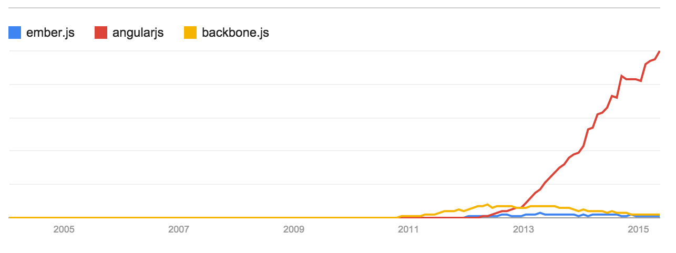
Popolarity

Slide 8
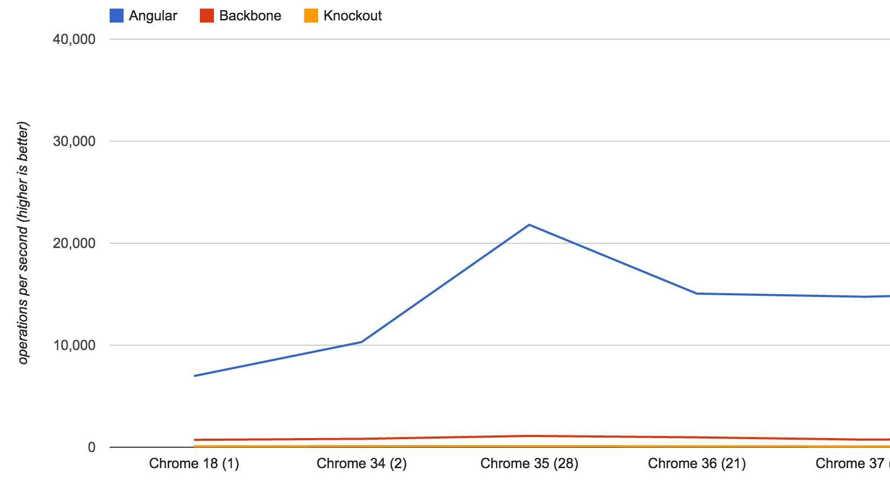
Performance

Slide 9
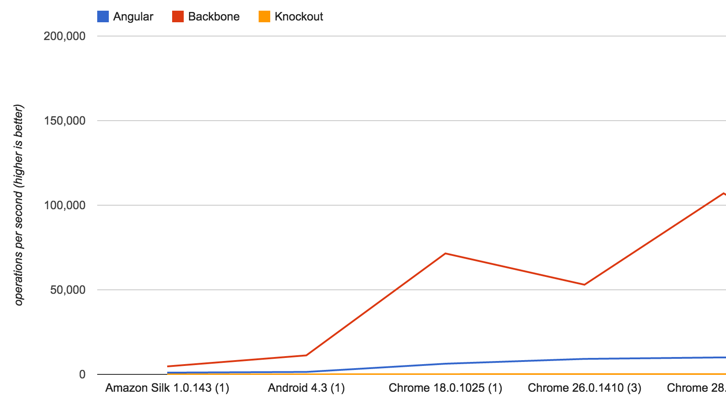
Performance

Slide 10
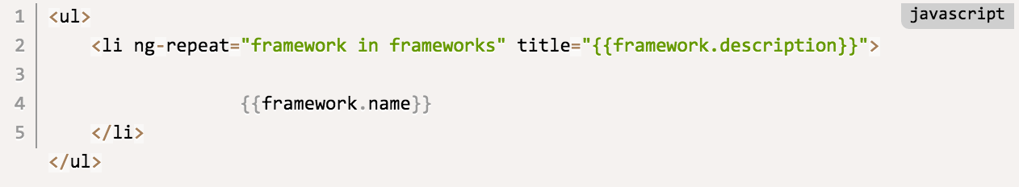
Code Structure - Angular

Slide 11
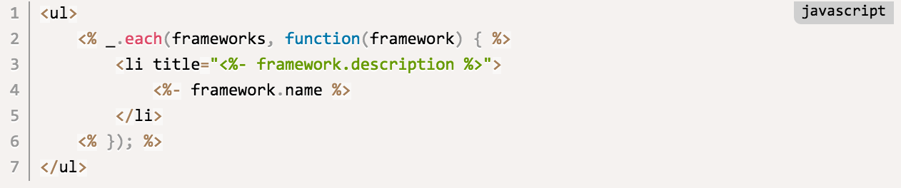
Code Structure - Backbone

Slide 12
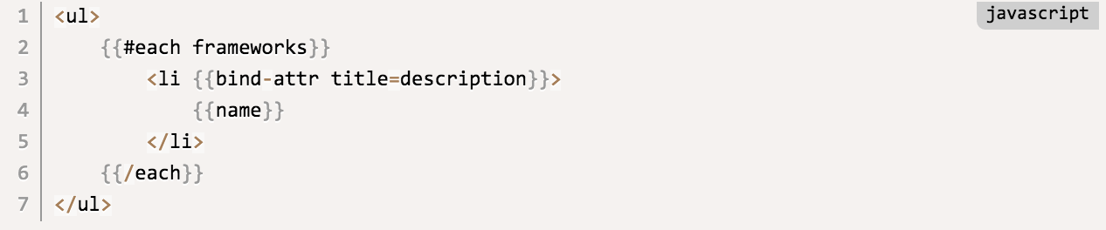
Code Structure - Ember

Slide 13
Conclusion
Backbone:
something flexible
support a persistence layer and RESTful sync
models, views (with controllers), event-driven communication
update the View when a model changes
decisions about the architecture left up to me
built non-trivial applications
active extension community around the framework

Slide 14
Conclusion
Ember:
tackle desktop-level application development
opinionated, modular, support a variation of MVC
No need to wire everything in my application together manually
auto-updating templates
support proper state management
extensive docs

Slide 15
Conclusion
AngularJS:
uses the View to derive behavior
custom HTML tags and components
easily testable
HTML compiler for creating my own DSL in HTML
URL management (routing)
upcoming Web platform features such as Web Components

